Slide 1
Business Communication Transformation
Reports

Slide 2
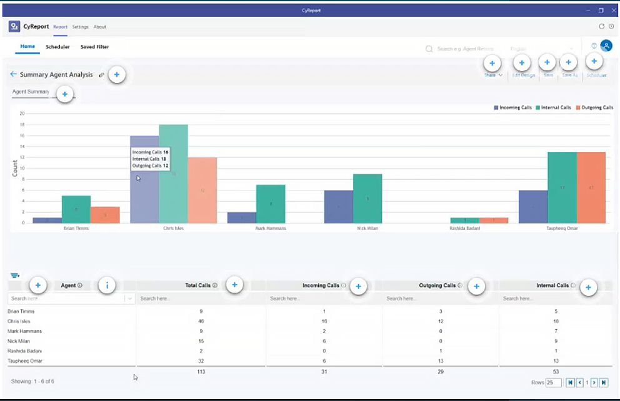
Business Communication Transformation
Summary Agent Analysis Report
This report is designed to offer a helicopter view and insightful glance at the overall picture enabling stakeholders in making informed decisions.

Slide 3
Summary Reports Interface
Business Communication Transformation

Slide 4
Chart View
Business Communication Transformation

Slide 5
Column View
Business Communication Transformation

Slide 6
Itemized Agent Analysis Report
Business Communication Transformation
An itemized Agent Analysis Report provides a detailed breakdown of specific information, offering a drill down view of individual components. The itemized report allows for a detailed examination of each element mentioned in the Summary Agent Analysis.

Slide 7
Itemized Agent Analysis Report Interface
Business Communication Transformation

Slide 8
Business Communication Transformation
Chat Report
Chat analytics provide detailed insights into staff interactions within one-on-one conversations, group discussions, and Microsoft Teams Channels.

Slide 9
Chat Report Interface
Business Communication Transformation

Slide 10
Chat Report Graphical Visualization
Business Communication Transformation

