Slide 1
Business Communication Transformation
CyCX – AI powered CX Contact
Centre Solution

Slide 2
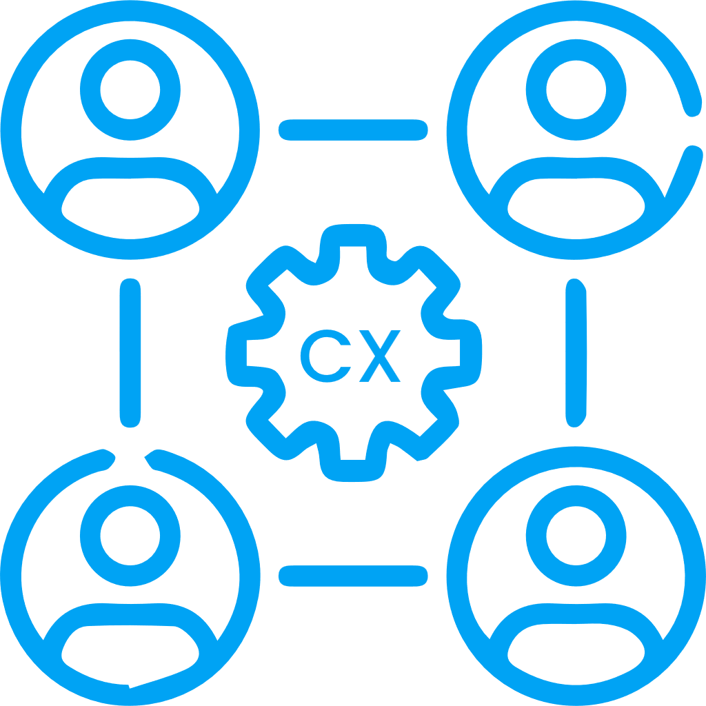
Business Case
Why Invest in CyCX? Revolutionize Your Customer Relationships with AI-Powered Contact Center Technology
Boost Efficiency and Eliminate Waiting Times
Don’t let your customers wait. With powerful workflow tools, AI-assisted & CRM enabled smart routing, CyCX instantly directs customers to the best-suited agent, improving first-contact resolution and reducing wait times.
The platform’s workflow and CRM integration further optimize the customer journey, allowing your agents to be more responsive and effective.
In today’s always-connected world, customer expectations are at an all-time high. Delivering exceptional service requires more than just responsiveness—it demands innovation.
CyCX, powered by advanced AI and designed for omnichannel engagement, helps your business exceed customer expectations by transforming how you manage customer relationships and interactions.
Meet Your Customers Anywhere, Anytime
CyCX’s omnichannel capabilities integrate AI, voice, chat, social media, and email, allowing you to connect with customers on their preferred platform.
A unified interface and a holistic view of customer history enable your agents to build more meaningful, personalized relationships. CyCX ensures you’re there for your customers when and where they need you, driving loyalty and satisfaction.
Enhance Customer service with AI-Powered Automation
AI isn’t just a tool—it’s a catalyst for growth. By automating routine tasks, CyCX allows agents to handle multiple calls and interactions simultaneously, eliminating delays and awkward pauses.
This efficiency gives your agents more time to focus on high-value tasks, such as nurturing customer relationships and driving revenue. Automated workflows also ensure consistent follow-ups and proactive service, leading to increased conversion rates.

Slide 3
Business Case
Leverage Real-Time Data to Make Smarter Decisions
CyCX’s AI-powered insights and real-time data allow you to monitor performance and adjust your strategy instantly.
With customizable dashboards that display key metrics such as service levels, customer satisfaction, and agent performance, you’ll have all the information you need to make data-driven decisions. Intelligent bots work behind the scenes, tracking service quality and alerting you to issues before they impact customer satisfaction.
Key Benefits of Investing in CyCX
Enhanced customer engagement across all communication channels
Faster response times with AI-powered smart routing
Increased agent productivity through automation of routine tasks
Actionable insights and real-time data for better decision-making
Ongoing performance improvements through AI-driven analytics and feedback tools
Scalable and future-ready platform to grow with your business
Continuous Improvement Through Insightful Analytics
Sustained success comes from ongoing optimization. CyCX’s actionable analytics and KPI monitoring ensure that your contact center continuously improves.
Tools like CySurvey AI agent QA, provides agents with self-evaluation features, delivering real-time feedback and performance insights that help your team members refine their skills. This not only increases agent productivity but also elevates the customer experience as your team gets better with every interaction.
AI: A Strategic Advantage in Customer Engagement
CyCX isn’t just a contact center platform—it’s a competitive advantage.
By leveraging AI, your business can anticipate customer needs, resolve issues faster, and create deeper, more personalized connections.
This combination of AI, omnichannel engagement, and advanced analytics positions your business to deliver exceptional service at scale, helping you stay ahead in a rapidly evolving marketplace
By investing in CyCX, you’re not just improving your contact center—you’re transforming the way you engage with your customers, drive revenue, and stay ahead in a competitive landscape. Experience the future of customer service with CyCX, and ensure that your business delivers the exceptional service that today’s customers demand.

Slide 4
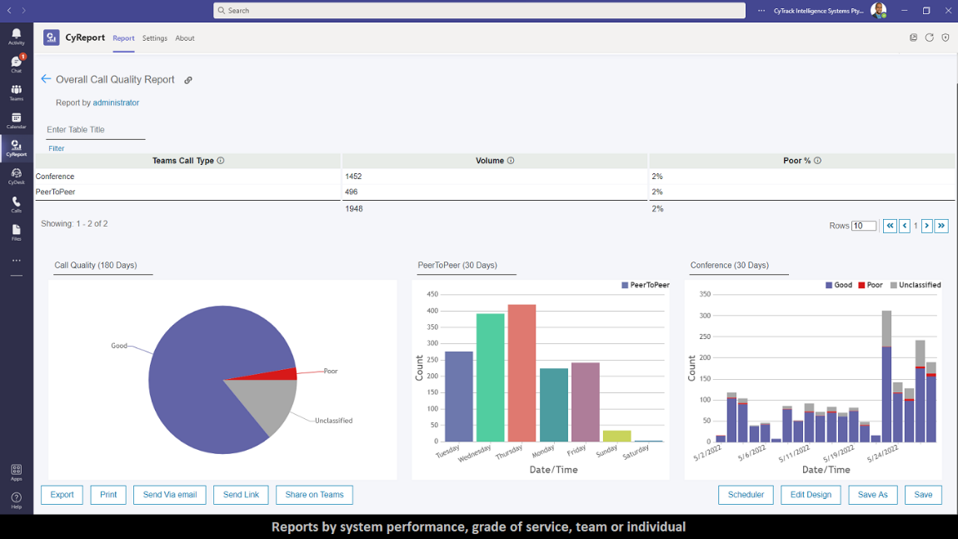
CyCX Contact Centre Solution in the Age of AI
Revolutionize Your Customer Experience with Cytrack
Cytrack’s AI-powered CyCX Contact Centre redefines the way you connect with customers. Our state-of-the-art technology boosts engagement, automates workflows, and maximizes performance. Empower your team with real-time insights, effortless automation, and advanced reporting tools. With Cytrack, your customer service team doesn’t just get smarter – they become unstoppable with features designed for excellence:
Smart Contact Center Agent Interface
Streamline your customer service and empower your agents with CyDesk, running in a browser or optionally integrated with Microsoft Teams, the powerful agent interface for the CyCX AI-powered contact center. CyDesk unifies communications, integrates CRM, and provides AI agent assistance to enhance efficiency and personalise every customer connection. With presence tracking and our awesome interactions view giving a centralised view of all customer touchpoints, your agents are empowered to deliver seamless, responsive service that improves satisfaction and operational flow.
Real-Time Analytics & Dashboards
Gain a competitive edge with CyCX’s live, customizable dashboards that offer an instant pulse on your contact center’s performance. Track key metrics like call volume, agent productivity, and customer satisfaction in real-time. Deep-dive into tailored reports that transform data into actionable insights, driving both efficiency and superior customer experiences.

Slide 5
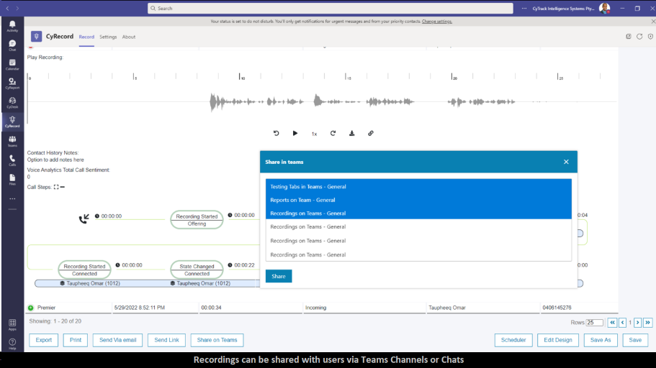
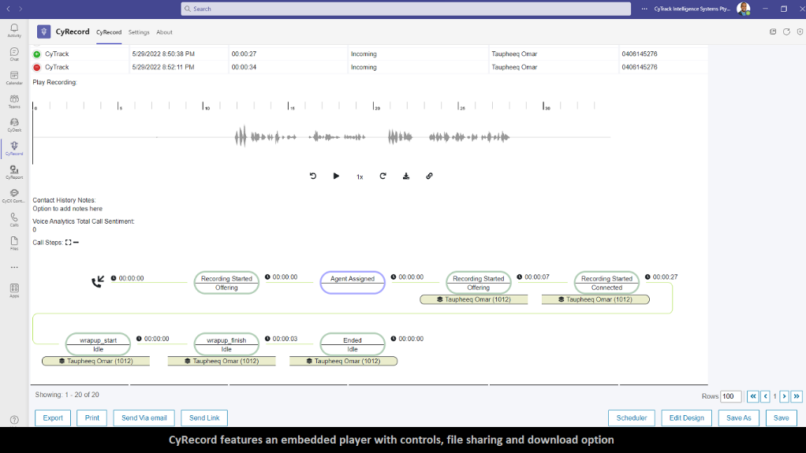
CyCX Contact Centre Solution in the Age of AI
Customer Satisfaction Surveys & Agent QA
Stay ahead of customer expectations with CyCX’s automated CSAT and QA surveys. Triggered after every customer interaction, these surveys provide immediate feedback and insights. AI-powered quality assurance reports streamline agent performance evaluations, using predefined criteria to ensure every interaction meets your high standards. Cytrack aligns your team with what matters most — customer satisfaction and service excellence.
Voice Recording, Training, & Compliance
Take training and compliance to the next level with CyCX’s comprehensive voice recording features. Choose between on-demand or full-time recording, paired with powerful transcription and sentiment analysis capabilities. Seamlessly integrated into our Call Steps reports, you’ll have access to the entire customer journey in one place.
AI-Powered Voice Analytics
Boost your team’s performance and recorded conversations with AI-driven voice analytics that transcribe every call, assess sentiment, and identify key discussion points. Effortlessly audit calls, resolve disputes, and ensure compliance while unlocking deeper insights. AI-generated call summaries and keyword searches make it easier than ever to spot trends and fine-tune your service quality, all while improving customer satisfaction.

Slide 6
CyCX Contact Centre Solution in the Age of AI
AI-Powered Chatbots & Agent Assist
Supercharge your customer service with CyCX’s AI-powered chatbots that handle customer inquiries 24/7. These intelligent bots provide instant, accurate responses, reducing wait times and freeing up your agents for more complex tasks. Seamlessly integrated with your CRM, they deliver personalized support and can escalate issues to a human agent when needed.
AI Assistant as Your Front Desk
Introducing CyCX’s AI Assistant — your virtual front desk that can answer and assist calls with the efficiency and professionalism of a human agent. This intelligent AI-powered assistant greets customers, handles routine inquiries, directs calls to the right department or individual with ease and ca even send forms and documentation via SMS or WhatsApp . Whether it’s scheduling appointments, answering FAQs, or providing important information, your AI front desk works 24/7 to ensure no call is missed.
Agent Assist further empowers your team by providing real-time AI recommendations during live interactions. From suggesting answers to frequently asked questions to offering insights based on customer questions, Agent Assist ensures your team responds faster and more accurately. With AI on their side, your agents are equipped to handle even the toughest queries with confidence and precision.
This powerful virtual receptionist not only reduces wait times but also allows your human agents to focus on high-value tasks, ensuring a smoother, faster customer journey from the very first interaction. The AI Assistant can escalate more complex queries to a live agent whenever needed (ensuring via our Agent Assist that the agent has all the details of the conversation so far, ensuring every customer is handled with care and precision.

Slide 7
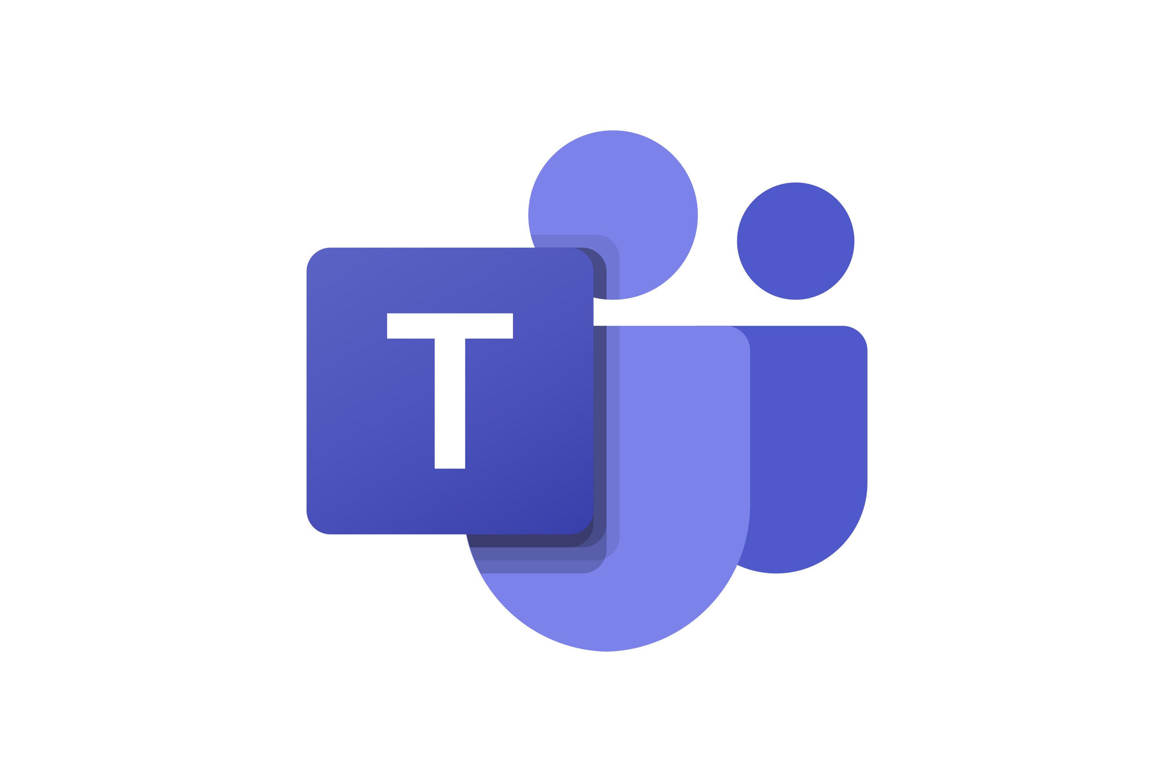
CyCX Contact Centre Solution in the Age of AI
Microsoft Teams Integration (optional)
Take your contact center to the next level with CyCX’s native Microsoft Teams integration. Real-time dashboards, reports, and alerts are embedded directly into the tools your team uses daily. High-priority notifications and performance alerts ensure you never miss a critical moment. It’s more than just communication; it’s intelligence in action.
With CyCX fully integrated into Microsoft Teams, agents can manage every aspect of customer interaction from one centralized platform. From seamless call handling to instant CRM screen pops, CyCX ensures agents have all the tools they need to deliver personalized, context-rich support from the first hello. No more juggling between systems — just smarter, faster service.
With Cytrack’s AI-powered solutions, your contact center is equipped to deliver faster, smarter, and more personalized customer experiences — setting a new standard for excellence.

Slide 8
CyCX Contact Centre Omni Channel Collaboration
The Benefits of Omnichannel Communication – Connect with Customers Anywhere
In today’s fast-paced, connected world, your customers expect seamless communication across multiple platforms. With CyCX’s omnichannel contact center, you can engage with your customers wherever they are, creating a unified experience that builds trust and satisfaction.
Chat
Customers increasingly initiate their relationship with your business online. With CyChat, it’s a simple next step to click and chat with your team. Manage agent rules and allocations easily while displaying chat presence to the team.
CyChat integrates communications and interaction history into agent records and adds all relevant data to your CRM for seamless reporting.
SMS
SMS is an increasingly vital communication tool for customer service. CyCX allows customers to connect through SMS in queue, request SMS Call-Me, or send Telemarketing SMS bulk-outs.
Administrators can receive system alerts via SMS, and agents can communicate with clients, partners, and team members directly through SMS, adding flexibility to your contact center.
Social Media
With CySocial, Cytrack’s social messaging server, your business gains the ability to communicate in real-time via WhatsApp and Facebook Messenger. Engage customers through rich media chat, making collaboration easy and efficient, no matter which social platform they prefer.
Web Call-Back
Harness the power of the web to engage with customers directly from your webpage. With Web Call-Back, customers can join a queue, and agents receive a pop-up showing the webpage the customer was viewing before they receive a telephone call-back, making interactions more personalized and efficient.

Slide 9
CyCX Contact Centre Omni Channel Collaboration
The Benefits of Omnichannel Communication – Connect with Customers Anywhere
In today’s fast-paced, connected world, your customers expect seamless communication across multiple platforms. With CyCX’s omnichannel contact center, you can engage with your customers wherever they are, creating a unified experience that builds trust and satisfaction.
Telemarketing & Outbound
Go beyond traditional telemarketing by using CyCall, CyCX’s omnichannel outbound and telemarketing contact center. By proactively creating opportunities, your agents can engage more customers and prospects, helping your business build lasting relationships.
Self-Service & IVR
CyLive Intelligent IVR allows you to offer personalized, efficient service—without human interaction. This feature includes a user-configurable interface with a flow-chart design tool, allowing your business to create and manage sophisticated, self-service IVR solutions easily.
AI-Enhanced Communication – The Future of Customer Engagement
As customer expectations grow, AI is the key to delivering faster, smarter, and more personalized service.
With CyCX AI, add an AI-powered channel to your contact center that elevates customer interactions across all platforms.

Slide 10
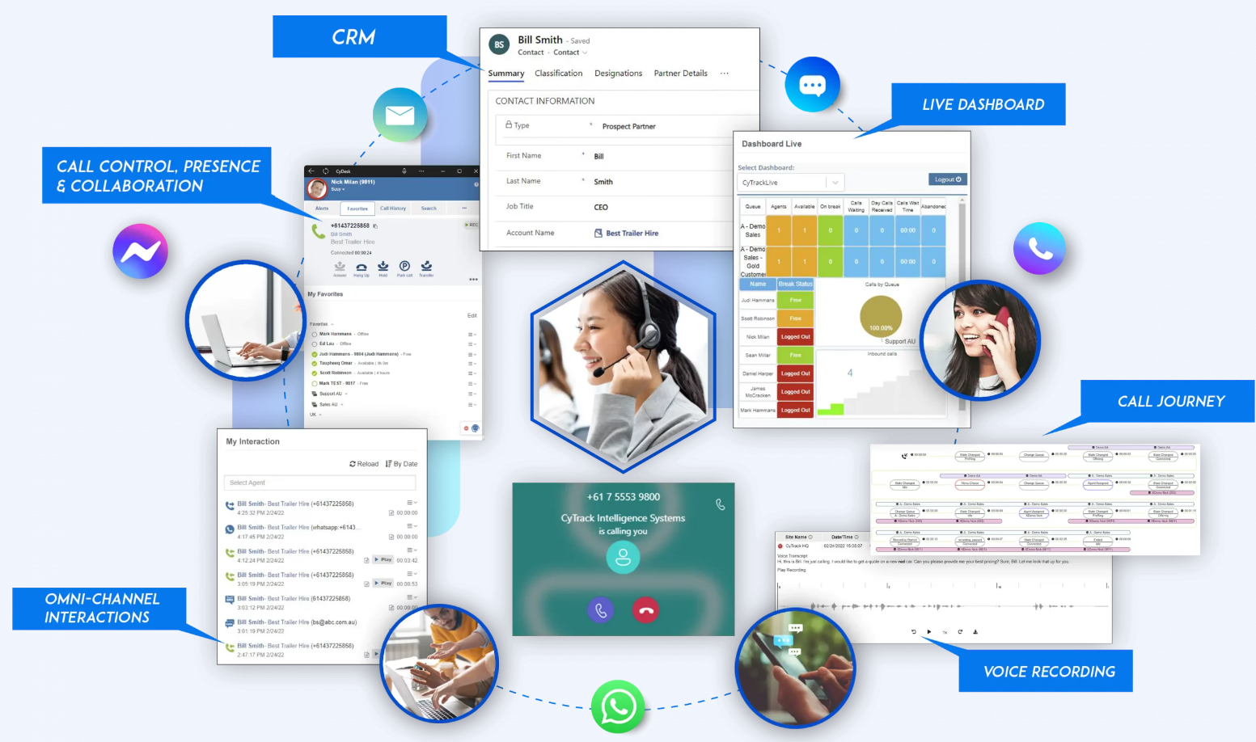
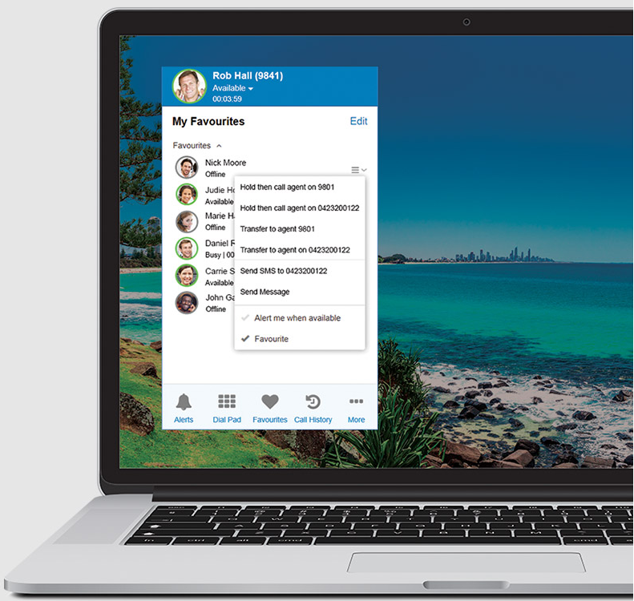
The CyCX Solution
CyCX goes beyond traditional ACD systems providing you an array of communication channels such as Voice, SMS, Email, Fax, Web Chat, Web Call-back, Call back in Queue and Social Media connections meaning you can connect on any level.
"Your Call" really has become important
It's the all centre cliché: "your call is important to us, please continue to hold and we will answer your call as soon as possible". However, behind this original (and overused) queue message is a core principle for any successful business - your customer's call really is important!
When a customer takes the time to contact you, whether by voice call, SMS, email or social media, it is a rare opportunity to build loyalty. By offering a true omnichannel choice in how they communicate with your business, giving them relevant information and making better use of your support staff through intelligent routing, you can capitalise on this connection and let your customers know their call really is important to you.
Easily answer and transfer calls with the click of a button
CyDesk is integrated into CyCX allowing calls to be answered, put on hold and transferred with the click of a button. Agents can select from a range of transfer options; they can SMS or instant message colleagues or have CyDesk alert them once a busy user is made available.
This intuitive and flexible system ensures an efficient and cost effective platform for your organisation, whilst providing the highest quality customer experience.

Slide 11
The CyCX Solution
Customer experience is the new currency of power
Many products are commodified, meaning profits are harder to make by simply focusing on price. However, by improving customer experience, businesses can differentiate themselves. A company with effective customer experience strategy and technology will therefore rise above the competition and become the go-to business for today's ever more discerning customers.
Spending is geared heavily towards marketing, and for this reason, companies often fail to budget effectively for the development of their customer experience. With power shifting to consumers and therefore to the companies that earn their loyalty, customer experience really is the new currency of business.
Update availability status
Users can quickly and easily update their status to any one of the options pre-defined by the administrator. CyDesk displays the status of other users and how long they have been away.
If a user wishes to contact another user who is currently unavailable, they can set an alert to identify when they become available.
Powerful supervisor monitoring tools
Due to the flexible web based architecture, supervisors can log in and monitor their teams from anywhere using the powerful tools integrated into CyDesk.
Supervisors can see a log of all the calls made or taken by each agent and when used in conjunction with CyRecord, individual calls can be played back at the click of a button.

Slide 12
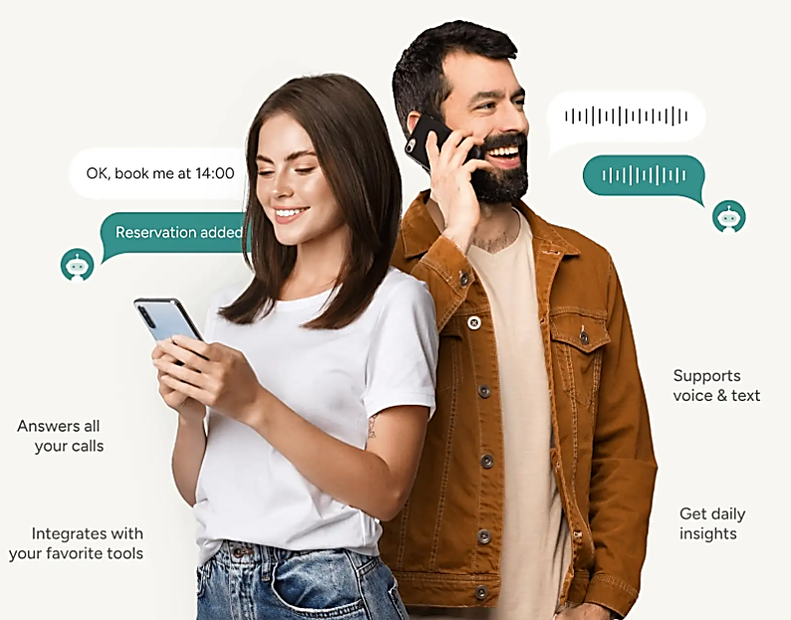
The CyCX Solution
Talk less achieve more
Cytrack’s Attendant AI and WhatsApp assistant, that will boost your business, increase customer happiness and reduce time spent on calls, freeing your agents to focus on complex jobs.
Serve longer, staff smarter
Automatically provide 24/7 service hours, tackle queries
anytime, and boost customer satisfaction
Minimize daily stress and friction
we manage calls, eliminating interruptions and efficiency loss, so you can excel in your business.
The AI Attendant that lets you focus on what's important.
Hi this is Anna at ABC Hospital, how may I help You?
I would like to make a booking for my procedure
I can send you a booking form via WhatsApp –
can I use the number you have called from ending
in 2323..
Never miss a sale again
Every missed call is potential lost revenue. Answer every call, seize every lead, and instantly boost your bookings.
Simplify your business workflow
Effortlessly connect to your vital tools – booking software, CRMs, Office 365, Google Calendar,
and more.
Yes that’s great thanks
That is one – what else can I help you with ?

Slide 13
Web Chat & AI
Conversational AI powered contact centers enable better agent and customer experiences
Our CyCX Chat Agent Assist with AI supports and complements your human agents. Whatever the communication channel (WhatsApp, SMS, or CyCX live chat) used for customer support, the information an agent needs to serve the customer is delivered to their screen instantaneously, without them having to search for it.
CyCX Chat Agent Assist also provides additional resource capability to complement human agents, providing customers with a personalized, quick and accurate service at scale, when
and where the customer wants.
Delivering on your customer promise
Helping agents help customers. Bringing together conversational AI solutions and the human touch.
Our conversational AI powered agent understands humans, is available 24×7, and is able to respond to customer queries faster than any human is capable.

Slide 14
Web Chat & AI
64% of customer service agents who utilize AI chatbots are able to spend most of their time solving difficult cases
Virtual customer assistants help organizations reduce call, chat, and email inquiries by 70%.
57% of executives said that chatbots bring significant ROI with minimal effort.
The right information is provided automatically to the agent when they need it
Automatic triggers for handover to a human agent with agreed rules. Complete conversation history handover from virtual agent to
human agent
Agents focus on high value and rewarding interactions, with automation taking care of repetitive time consuming requests
Increase efficiency and productivity with solutions that support agents
Virtual Agents are always online to assist customer (24x7)
Human agents automatically presented with responses found in virtual agent knowledge base as customers ask questions
Agent empowered with options to either respond with answer suggested, edit answer or provide different answer

Slide 15
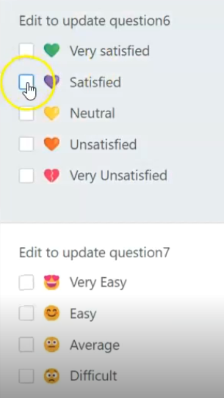
CyCX Survey
Measure Customer Satisfaction & Quality Assess Agents performance
CySurvey allows you to design and create your own surveys. With CySurvey you measure your customer's satisfaction with your business and create powerful agent assessments for Quality assessments and training – all in the one app !
Powerful easy to use Survey Designer
Create your own surveys and set as default against contact centre queues and agent profiles
Email/SMS delivery for CSAT
Send customer satisfaction surveys to customers for every call as either SMS or email
Gain the 'voice of the customer’
Build skills, confidence and performance of your team.
Your people act on the front line and are the face of the company when you encounter your customer. They deliver the 'moment of truth' which determines a customer's perception of, and reaction to, your brand and business. Moments of truth can make or break your organisation's relationship with your customers.
Integrated to agent interactions
Agent can view their customer and supervisor ratings against each call
Automate with AI
Automate and rate agents using AI to match each call against your designed survey questions
One tool for both customer satisfaction and agent assessments
Survey creation designer with wide range of question types such as Y/N, Thumbs, Hearts, Smiley Faces, Net Promoter Score and text input
Results displayed in agent interaction history, integrated call journey, reports history and management dashboards
Send CSAT via Email or SMS
Integrate to Agent Interactions and Call history showing star rating
Optional AI auto agent rating and call attribute collection

Slide 16
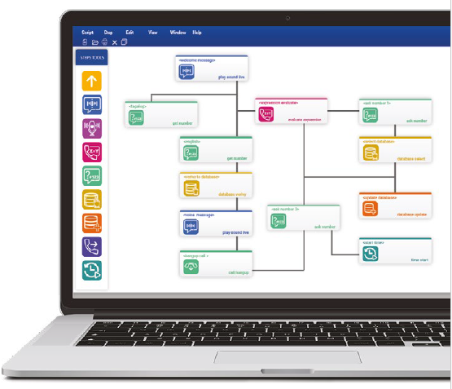
IVR & Self Service
Providing your customers with self service automation is a must. More and more industries and businesses are adopting this as a means to improve efficiency, reduce costs and create an environment of empowerment.
CyLive is a powerful Interactive Voice Response (IVR) engine and management module designed to offer very sophisticated features. The user configurable interface uniquely provides an IVR designer tool in flow chart design.
Why CyLive
Offer your customers self service.
Save high skilled human resources for complex and more personal tasks.
Create new services.
Enrich customer relationships.
Increase efficiency and lower costs.
Empower your business.
CyLive IVR Designer Tool.
Real-time monitoring.
Reports generator.
Typical applications
Customer Pin Code Verification
Route callers to CyLive IVR solution to collect a unique customer pin to then allow access to personal information or customised services.
Verified Access & Control
Allow calls based on a unique pin and to approved numbers only, set call budgets for call cut off and other controlled operations
Customer Self Service
Scripts can be developed to provide online customer payments and real time verification in conjunction with compatible e-commerce systems

Slide 17
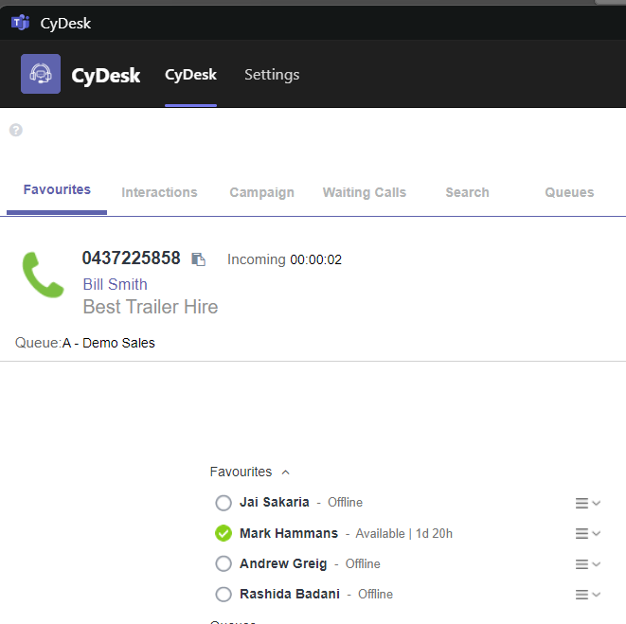
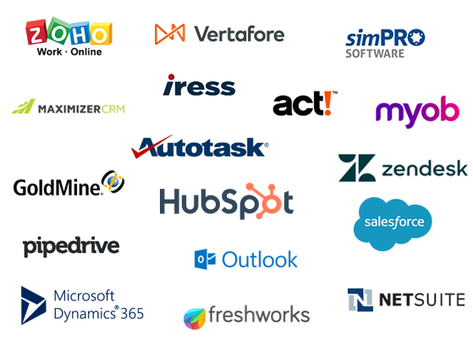
Integration with CRM
Integrate with 100’s of leading business apps – as well as your company’s existing in-house solutions – straight out of the box. Or create customized integrations and apps to suit your business’s unique needs. Integrate all channels of communication within your CRM, making it easy to communicate and access information from a single location without switching between applications.
Cytrack is compatible with Salesforce, Microsoft CRM, Freshworks, Zoho CRM, Netsuite, GoldMine, Pipedrive, simPRO, Vertafore, Xplan, MYOB – along with many other leading apps.
Cytrack specialises in CRM integration, as well as out of the box integrations we have created our own special development kits and API’s that your own technology specialists or partners can easily use to embed our controls into your own app and talk directly to our call control, reporting databases and dashboards. These are based on simple API’s that you can work with yourself or team up with the Cytrack integration team to create truly specialised applications to work with your IT strategy and architecture.
Click to dial for efficient outbound calling
Screen pop to provide caller details and call context
Log call details to CRM for history and help keep track of how the call went, what was discussed and whether or not it was successfully resolved.
Link voice recordings and review important calls with transcripts and sentiment analysis
Update CRM fields from completion and account codes for record updates
And more

Slide 18
Actionable Insights
Identify your actionable Insights with CyCX
High-performing businesses are at the forefront of extracting value from advanced analytics. The capability to discern trends throughout the enterprise and tailor each customer's journey is no longer a luxury but a necessity for maintaining the agility and personalization vital for success.
CyTrack facilitates businesses in capturing and analyzing interactions across various touchpoints, empowering swift, informed responses to customers and facilitating superior decision-making.
CyTrack's platform furnishes data-driven insights derived from all customer interaction channels. Managers gain immediate access to crucial information, enabling them to optimize resource allocation, provide timely, data-backed coaching, and intelligently automate call routing.
CyCX CyReport Modern Web Analytics
Cytrack CyReport is designed for the cloud with a modern web user interface to deliver a wide range of performance and analytical reports. Use the Report Designer to create your own reports or select from the professional range of included reports. Set reports to be emailed automatically on your schedules and delivered directly to your email, or run ad-hoc reports and create your own filters for deep analysis of your business and team performance.

Slide 19
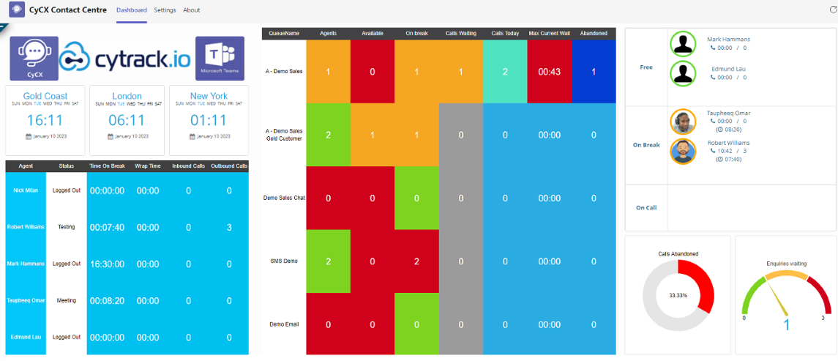
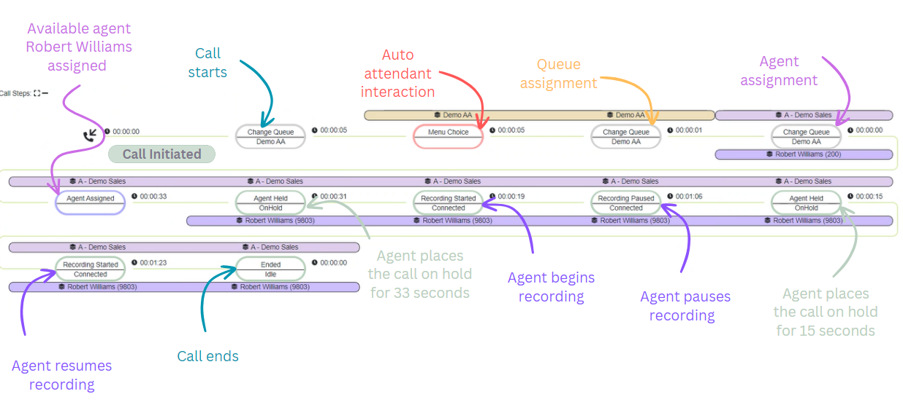
Actionable Insights
Powerful Dashboards
CyCX Dashboards play a pivotal role in your call center by providing real-time monitoring of performance metrics such as call volume, wait times, and agent availability. They enable supervisors to evaluate agent performance, optimize resource allocation, track progress towards goals, and gain insights into customer behavior. By offering a centralized view of critical data, dashboards empower call center managers to make informed decisions, enhance operational efficiency, and deliver superior customer service.
CyCX Customer Call Journey
Utilize CyCX to track and analyze your caller's journey from their initial contact with your call center to the conclusion of the call. CyTrack unveils every stage of the experience, including interaction with the interactive voice response (IVR), queuing, agent interaction, calls on hold, recording and post-call survey. Leverage this capability to gain an 'outside-in' perspective of your contact center operations, facilitating ongoing process enhancement and agent training.

Slide 20
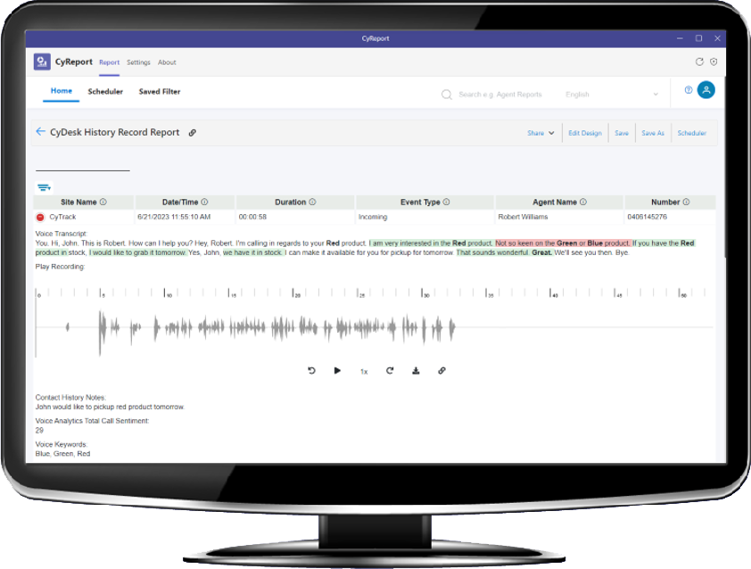
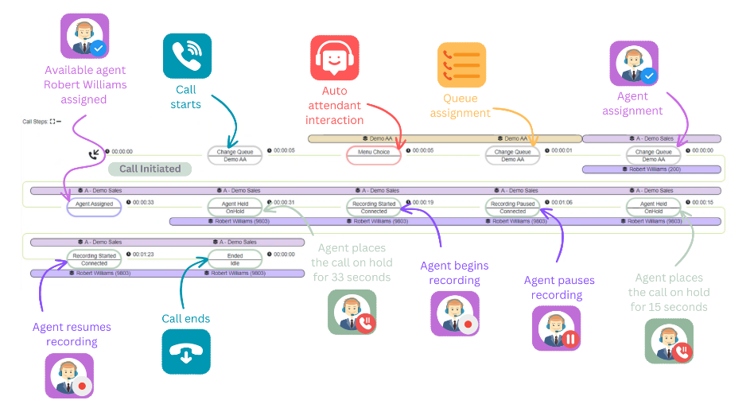
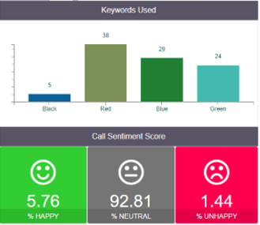
Actionable Insights & AI
Voice Analytics AI with transcription and sentiment analysis
Cytrack’s powerful Voice Analytics AI with transcription and sentiment analysis powered by Microsoft Cognitive Servicers offers businesses numerous advantages. By transcribing spoken conversations and gauging sentiment, CyRecord Insights provides deep insights into customer needs and preferences, leading to enhanced service quality and personalized customer experiences. This facilitates data-driven decision-making, streamlines compliance monitoring, and reduces costs by automating manual processes. Overall, it empowers your businesses to optimize operations, improve customer satisfaction, and drive growth.
With CyCX, listen to the voice of ALL your customers. Search for keywords and phrases, and delve into the details to understand what brings joy or frustration to your customers.
Data farm of statistics from CyReport, CyRecord and CyCX according to applications installed
Customer call journey, transcription and call sentiment analysis

