Slide 1
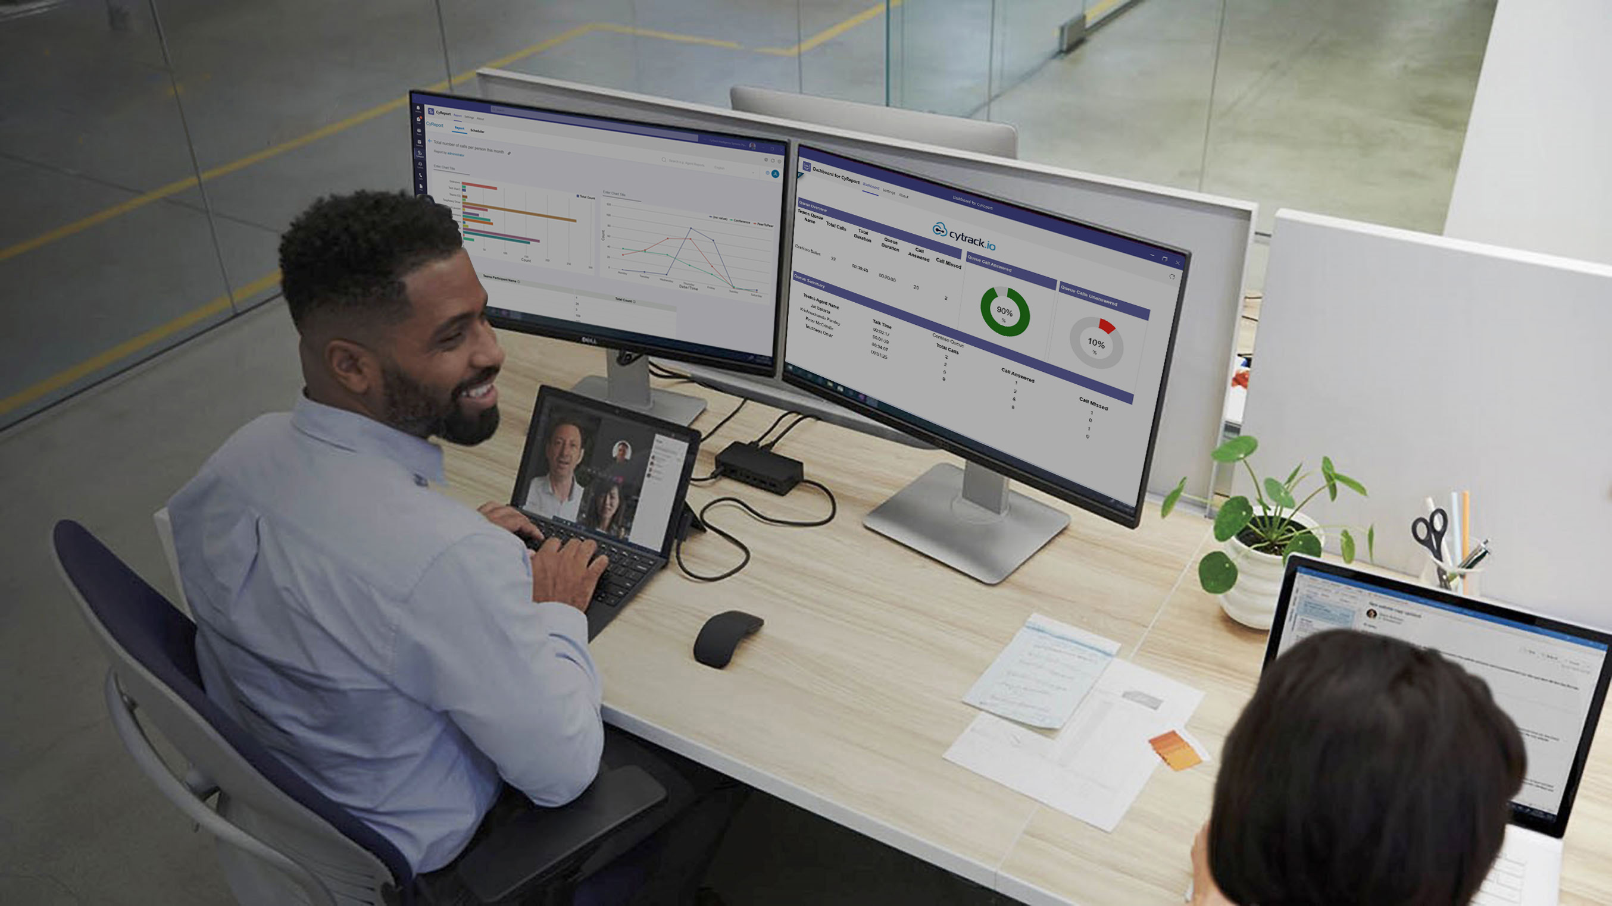


CyReport - Reporting & Analytics for Microsoft Teams
Empower hybrid workers with collaborative apps in Teams
Unlock actionable insights and enhance productivity with our advanced Analytics and Reporting for Microsoft Teams
v3
v2

Slide 2


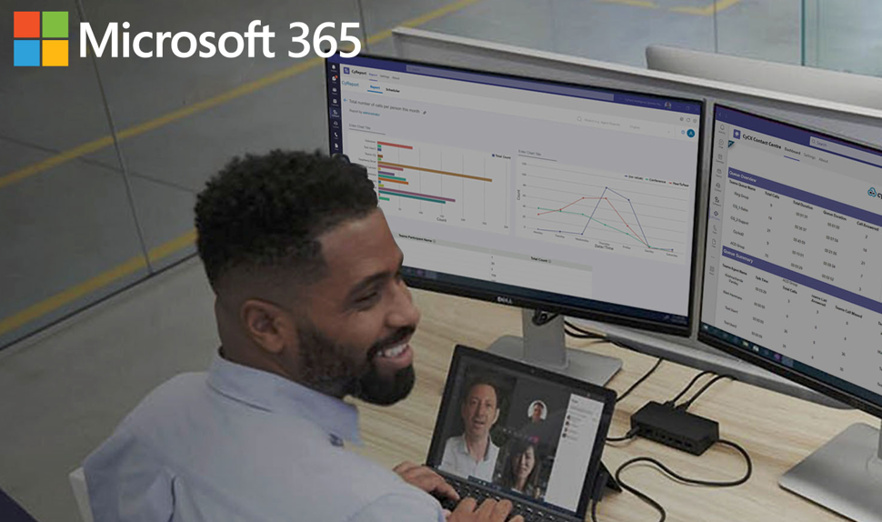

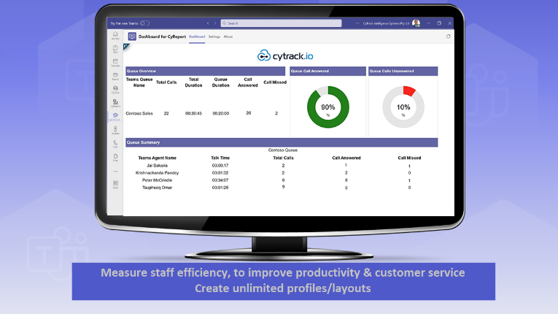
Agenda
Who is Cytrack ?
CyReport Reporting & Analytics for Teams
  Unlock actionable insights and enhance productivity with our advanced Analytics and Reporting for Microsoft Teams
Benefit through partnership together
  Sales & Marketing Support
  Sales Toolbox
  Customers love CyReport for Teams
  NEOS Customer Reference
Pricing Model
See it in action: CyReport for Teams
Q&A

Slide 3
Outcomes today
Tap into the extensive Microsoft Teams user base and network to reach a massive audience for increased sales opportunities
Augment & Amplify your Microsoft Teams Calling solutions
Associate our reporting analytics solution with your Microsoft Teams offerings for unique selling points, differentiating your offerings and gaining a competitive edge in the market.
Learn to explain to clients how CyReport will enhance their productivity
Discover Cross-Sell Opportunities
Learn how partners can build sustained professional service revenues

Slide 4

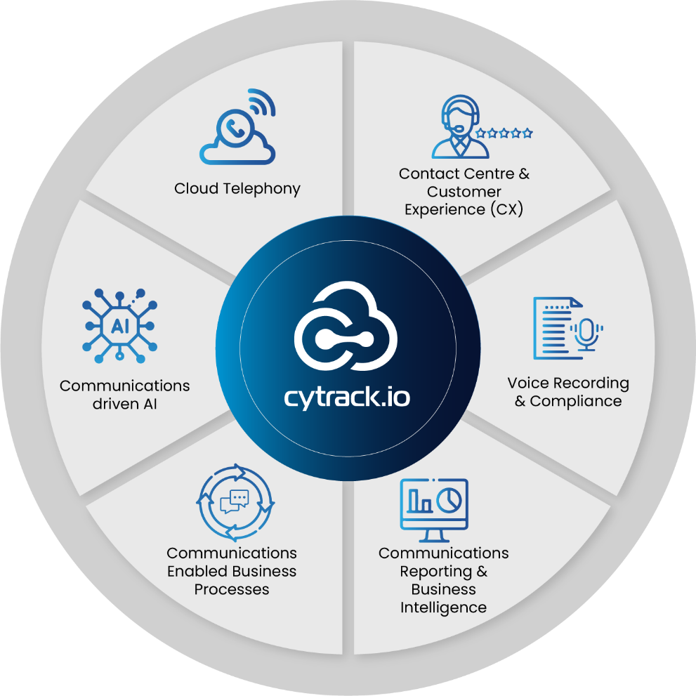




Business Communication Transformation
Cytrack is an Australian ISV, that has been in business for over 28 years, our products are distributed all over the world, we are a Microsoft Gold Partner and previous Microsoft Australia Partner of the Year award winner. We have a suite of solutions as fully transactable apps on the Microsoft Marketplace with more coming.
Global, experienced business partner
Cytrack solutions are deployed in over 20 countries across the globe
Microsoft Partner of the Year Award Winner
‘Excellence in Industry and Platform Innovation’

Slide 5
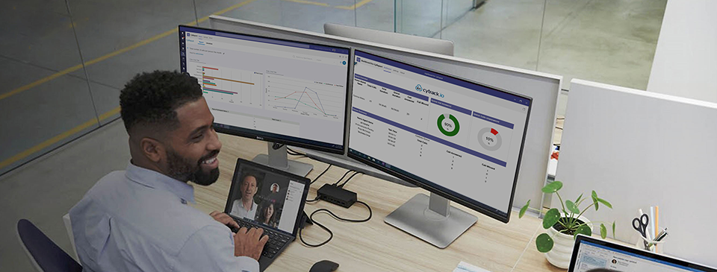


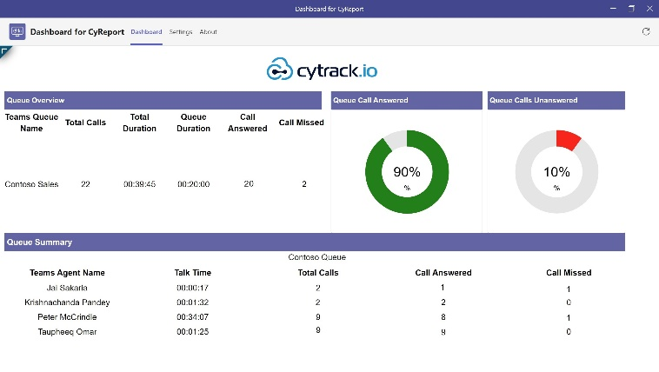
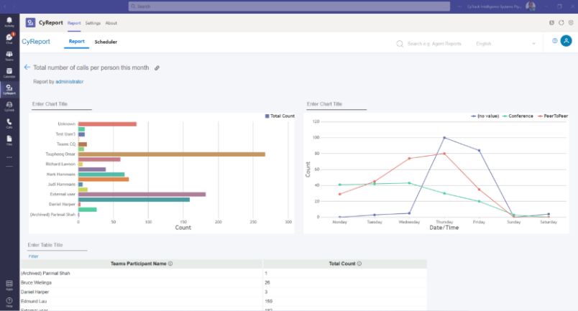

Communications & Performance
Analytics CyReport for
Microsoft Teams
Empower hybrid workers with collaborative apps in Teams
Manage your business communications performance & uncover data insights with CyReport in Microsoft Teams.
Measure your performance so you can manage it
Identify and reward top performers amongst your workers
Deliver the highest experience for your customers
Measure staff efficiency, to improve productivity & customer service Create unlimited profiles/layouts
Easily measure your key business metrics and what gets measured gets managed! Reports by system performance, grade of service, team or individual
Unlock actionable insights and enhance productivity with our advanced Analytics and Reporting for Microsoft Teams

Slide 6


^{Market Opportunity}
Unlock actionable insights and enhance productivity with our advanced Analytics and Reporting for Microsoft Teams
Customer Segments
Opportunities
Any Industry but specific gains seen in Healthcare,Transport, Logistics, Automotive, Finance
Businesses and non-profits with sales teams and customer-facing departments, such as customer support and customer service. Pre-req for call queue, agent and other phone system centric data requires users have the Microsoft Teams Phone Standard SKU’s. In summary, we cater to organizations of varying sizes, focusing on those with customer-facing departments and in particular those utilizing the Microsoft Teams Phone Standard
Average opportunity size- 15-500
Average customer size- 10-5,000 users
Sales Cycle to close- 30-60 days
Business Communication Transformation
www.cytrack.io

Slide 7

Can your customers answer these type of questions ?
Using Teams for telephony? Are customers abandoning or overflowing
to back up queues/voicemail?
Do you know how productive your workers are ? Can you identify and reward top performers?
When are your busy times? How do customers prefer to contact you ? Are your workers available ?

Slide 8


Customer Pain Points solved with CyReport for Teams
Business Owner: We moved staff to WFM during the pandemic, but now have customers complaining we aren’t getting back to them or are taking too long .. We don’t know how to measure this.
Operations Manager: Customers are complaining they get our voice mail and people aren’t answering - How many of our staff calls are going to voice mail ?
Operations Manager: How many chats are people having on Teams ? Are they 1on1 or group chats? What is this doing to our productivity?
Customer Service Manager: We have call queues setup in Teams and have no idea of how many calls we get, how long customers wait, what are our abandoned rates are ?
Customer Service Manager: Why aren’t we answering all our calls? How often are my team taking breaks, how long are they available ?
Sales Manager: I need numbers to show how many sales calls my team is making, who are the leaders ?
Sales Manager: We are aiming to win a valuable contract and have identified the key customer contacts, I want to know how often we are connecting with them, how many meetings have we had ?
IT Manager: We have so many Teams channels, they create sharepoint sites and its out of control, which Channels are not being used so I can close them down ?
IT Manager: People keep asking me for all these reports on their business area and PowerBI doesn’t give me what they want, and its expensive and difficult to use.
Everyone: I only want to see what I need not everything that our business does, and I want to see it in my Teams Channels not use a complicated analytics application

Slide 9

Customers love CyReport
Customers love CyReport
“I gave up on Power BI, CyReport had it all out of the box and I can customise my dashboards and reports so much easier”
You can be up and logging your Teams performance metrics in minutes
What gets measured gets managed, its so important for our business improvements
CyReport tells us how many of our staff’s calls are going to voicemail
CyReport shows us how many of our customers hung up before we answered them
CyReport gives us a dynamic list of all the abandoned callers for us to call back
CyReport grows with us, as we learn we want to know more
Use Cases
Key Features
How are your call queues performing?
Are customers hanging up before being answered?
How many video meetings are you having?
Which team members are the busiest and with whom?
How many chats are happening daily, what
are the teams responses?
Analyse sentiment, team emotion and participation.
Powerful configurable Dashboards
Wide range of prepared Reports
Customize your own with our Report Generator
Schedule reports and alerts to email, Teams members and Channels using Teams Adaptive Cards
Embed contextual reports and dashboards using Teams customizable tabs

Slide 10












Benefit through partnership with Cytrack
Elevate & Differentiate
bigger margin opportunities
secure more Microsoft
subscription revenue
Massive opportunity
Improved Productivity
Microsoft Teams has a vast user base of 100 million users and an established ecosystem. By integrating our reporting analytics solution with Teams, partners can tap into this extensive network and potentially reach a wider audience.
Associating our reporting analytics solution with your Microsoft Teams offerings provides unique selling points, differentiating your offerings and gaining a competitive edge in the market. Encourage customers to switch to you for all their Microsoft subscription billing.
By providing our reporting analytics solution embedded within Microsoft Teams, our Partners enhance the productivity of your clients. Microsoft Teams becomes a one-stop platform for both collaboration and data analysis, reducing the need to switch between different applications.
Sustained professional service revenues
Security and Compliance
Cross-Sell Opportunities
Driven by customers’ continuous desire to progress with CyReport. As their knowledge grows, so does their appetite for more intricate dashboards and comprehensive reports to analyze and report on business performance.
Leveraging Microsoft Teams’ security features ensures that our reporting analytics solution adheres to stringent security and compliance standards. This reassures partners and customers regarding data protection and regulatory requirements.
Integrating with Microsoft Teams opens up opportunities for cross-selling other Cytrack products and related solutions. Partners can explore synergies and present a holistic suite of solutions to customers.

Slide 11

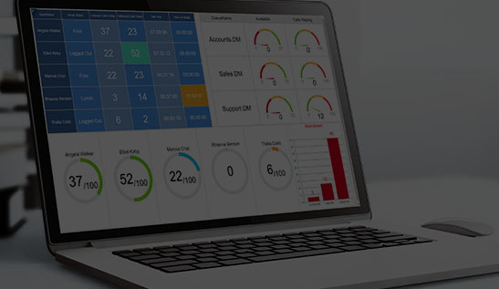










Benefit through partnership with Cytrack
Customer Satisfaction and Retention
Partner Tenancy Dashboard
Market Positioning and Competitive Edge
Offering our comprehensive reporting analytics solution integrated with Microsoft Teams enhances customer satisfaction. It meets customers needs for a consolidated platform and fosters long-term relationships, potentially leading to increased customer retention rates.
Our unique partner dashboard provides insights across your client user sites such as number of users licensed and key performance statistics such as call volumes, abandoned rates, agent availability and more. Partners can create unique services, threshold alerts and consultancy to your client base with this powerful tool.
Our reporting analytics solution is on the Appsource and Teams Store and available via the Microsoft Marketplace. Our Partners use this association as a unique selling point, differentiating their offerings and gaining a competitive edge in the market.
Evolve alongside your clients
Augment & Amplify your Microsoft Teams Calling solutions
Co-branding Portal
Are driven by customers’ continuous desire to progress with CyReport. As their knowledge grows, so does their appetite for more intricate dashboards and comprehensive reports to analyze and report on business performance.
Increase your recurring subscription revenue and profitability from Microsoft Teams services and license sales.
Add your business logos to our apps for differentiation and corporate standing.
Differentiate - yourself by showcasing deeper expertise in Microsoft Partner solutions.

Slide 12

Why Partners are loving CyReport for Teams
There are now over 100 Million Teams users and this is a massive market opportunity for me to add value add services
My customers have a lot of pain points that are solved by CyReport, I add a valuable service at an affordable price, “what gets measured gets managed” is my mantra to my customers now !
I love that CyReport enables me to differentiate my service offering, many partners are just competing to the bottom with low profit carriage packages
I make very small margins on Azure and M365 subscription revenue, I make at least double with CyReport
I love that CyReport is on the Microsoft Marketplace so its simply added to my customers existing invoice from Microsoft – and I am convincing new customers to select us as their partner of record for their Microsoft license services, that is very sticky and increases our revenue and reported sales with Microsoft that leads to other Microsoft benefits.
CyReport Analytics generates ongoing services revenue beyond the initial deployment, the more customers learn about their business the more they dig deeper and get hungry for new insights and reporting outcomes.
Did I say how affordable it is ? $250 a month for up to 50 users is amazing value
Cytrack has made it so easy, the system is spun up automatically once subscribed via the Microsoft Marketplace via automated deployment and then Cytrack have provided amazing e-learning modules, even down to how to use individually reports – its next level !
Oh ! One final thing I can even brand CyReport for Teams with my own logos ! That makes my business look very professional and differentiates us in the total solution, we are all in !

Slide 13



Target Industries
Target Customers
Any industry that uses Microsoft Teams and wants to report & analyse on usage, performance and customer experience
Large Enterprise with many thousands of users
^{Small Business from 3+ users}
Objection Handling
Doesn’t Teams give you this information out of the box ?
Solution: Certainly not, you must access the data via Microsoft API’s and the data is very complex to interpret. CyReport contains professional Dashboard and Report templates ready to go that have been designed with professional call centres and telecom experts since 1995
I can do this with Power BI can’t I ?
Solution: If you have a team of experts and are prepared to develop and maintain Power BI, maybe some of it, but it’s complex and the Dashboards and Reports we provide are based on techniques learned over years of experience in telephony and contact centres. Most of the enquiries we get are from IT experts with Power BI specialists who have just given up and are looking for a solution that does it for them and constantly delivers innovative exciting features. Save all your time and money trying to develop this inhouse, CyReport is so affordable.
My staff doesn’t look at wallboards or go searching for reports
Solution: CyReport Dashboards can be embedded into Teams Channels and automatically post alerts to your channels on key thresholds and KPI’s. Reports can be setup to be emailed automatically to key stakeholders or groups based on set rules
These analytic type products seem to require so much customisation and take months to get running!
Solution: CyReport connects to your Teams data as part of an online process and is logging information for you immediately. After that our system has Dashboards and Report templates that are configured with your organisational Teams settings and members straight away. You will be making decisions to improve customer service within days.

Slide 14

Measure your performance so you can manage it
Powerful Dashboards
Wide range of report templates and report designer
Create alerts and updates to users & channels with use of adaptive cards and customized tabs in Teams

Slide 15
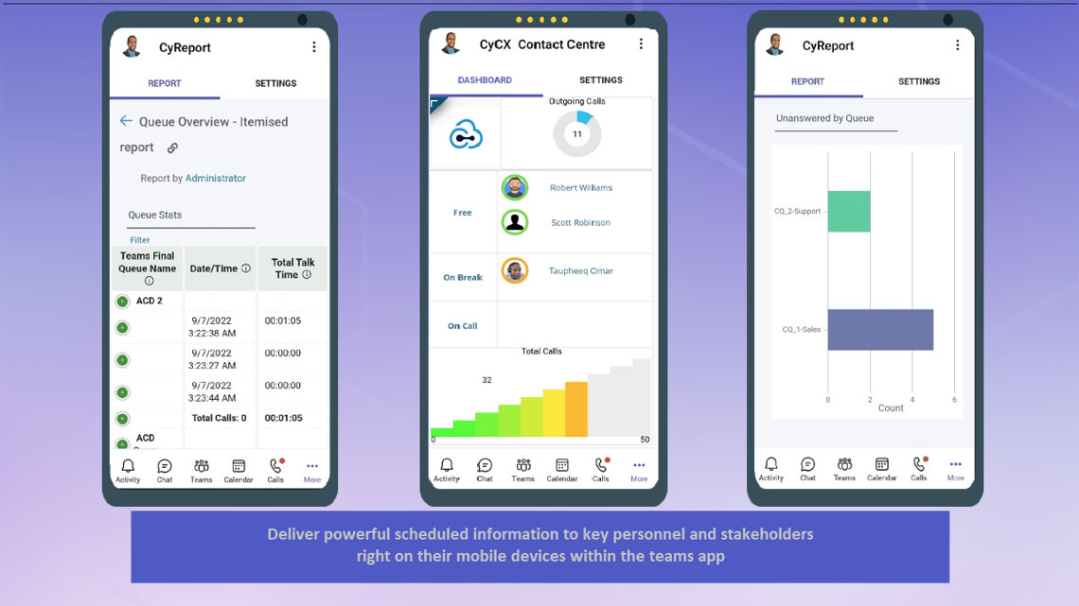
identify and reward top performers amongst your workers
Activity and Trend reports and dashboards
Leaderboards
Gamify the performance

Slide 16
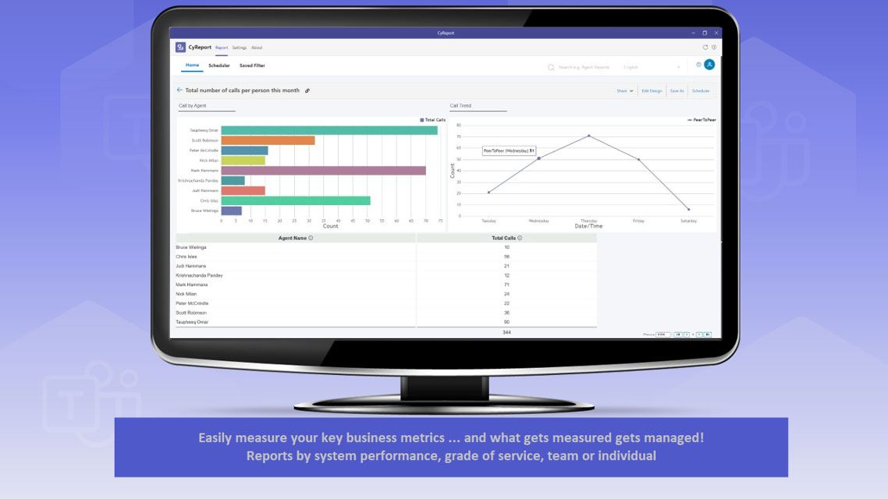
Deliver the highest experience for your customers
Report on Abandoned calls and traffic ending up in voice mails
Analyse quality of service
Identify busy time trends and worker availability

Slide 17
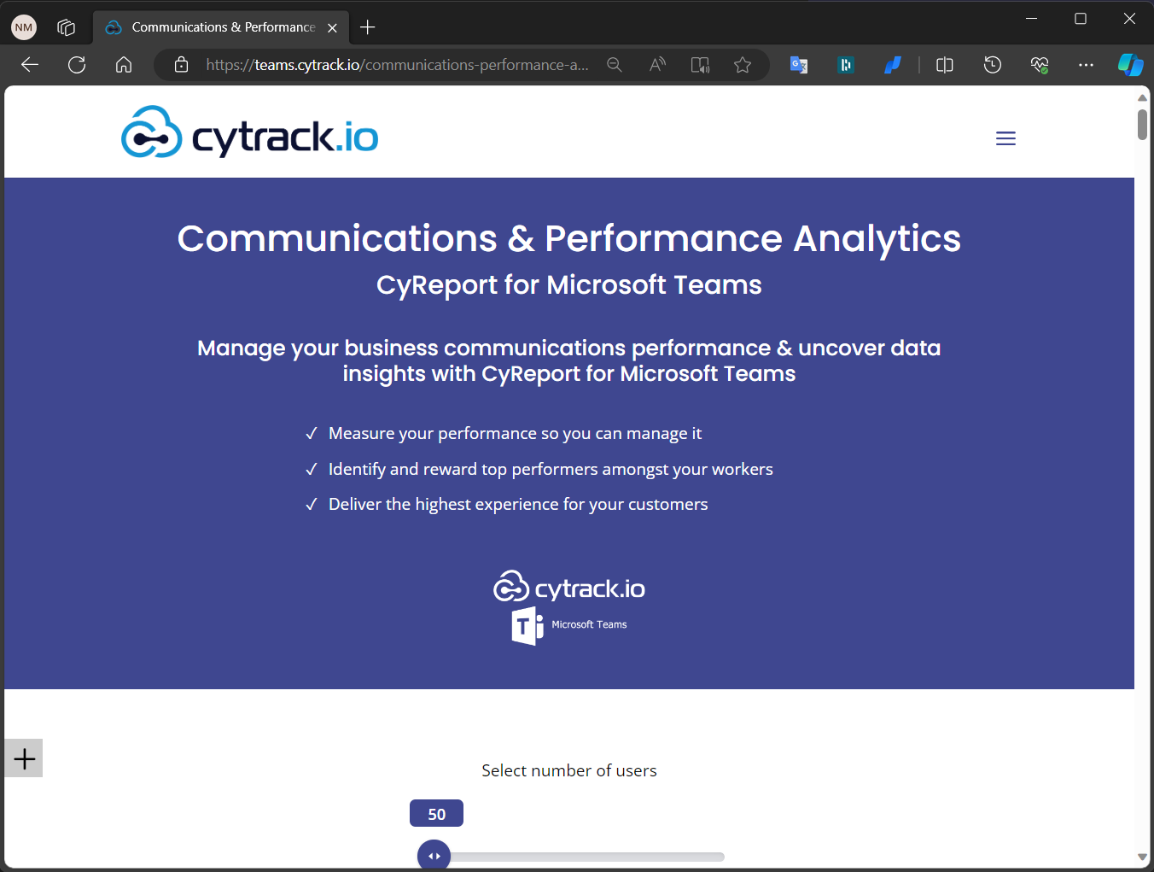
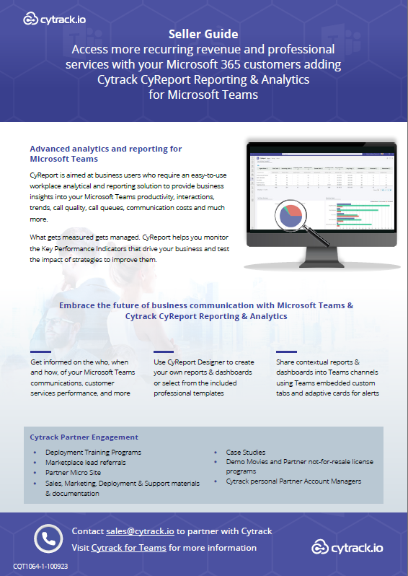
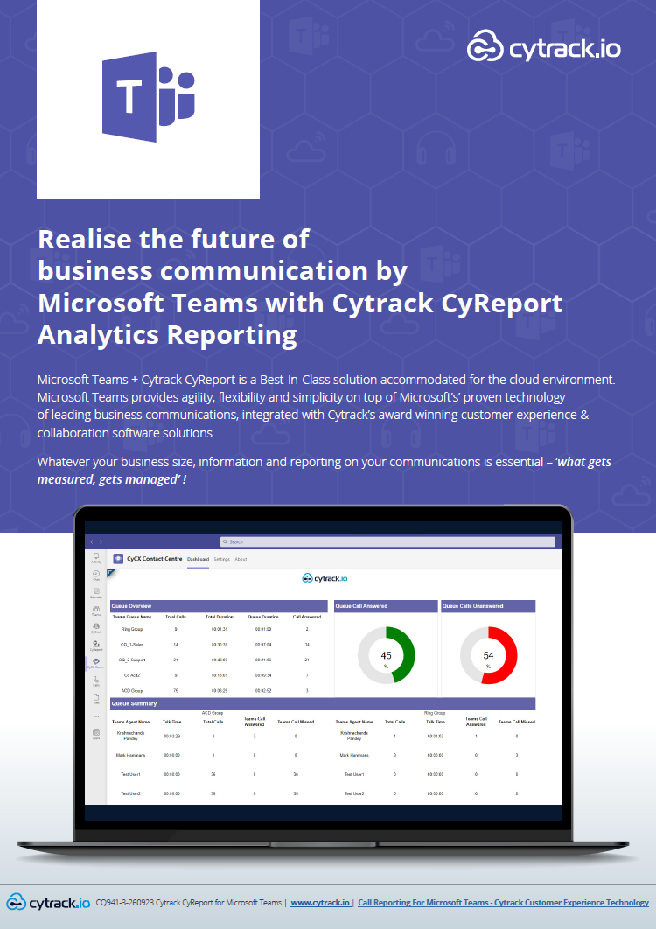
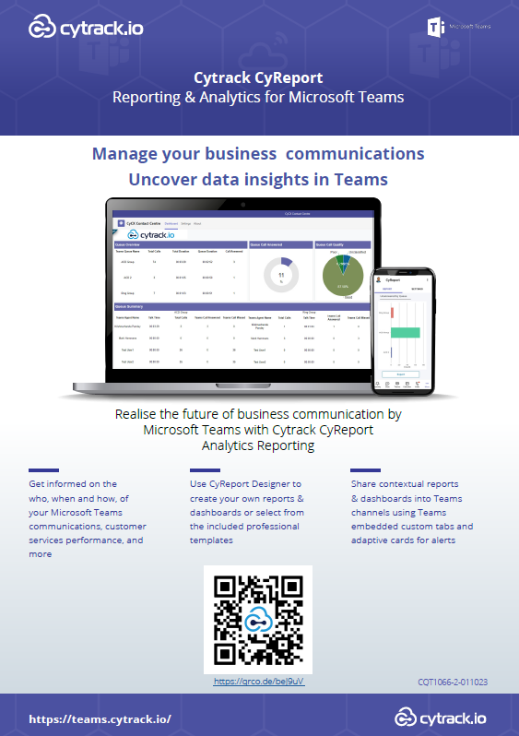
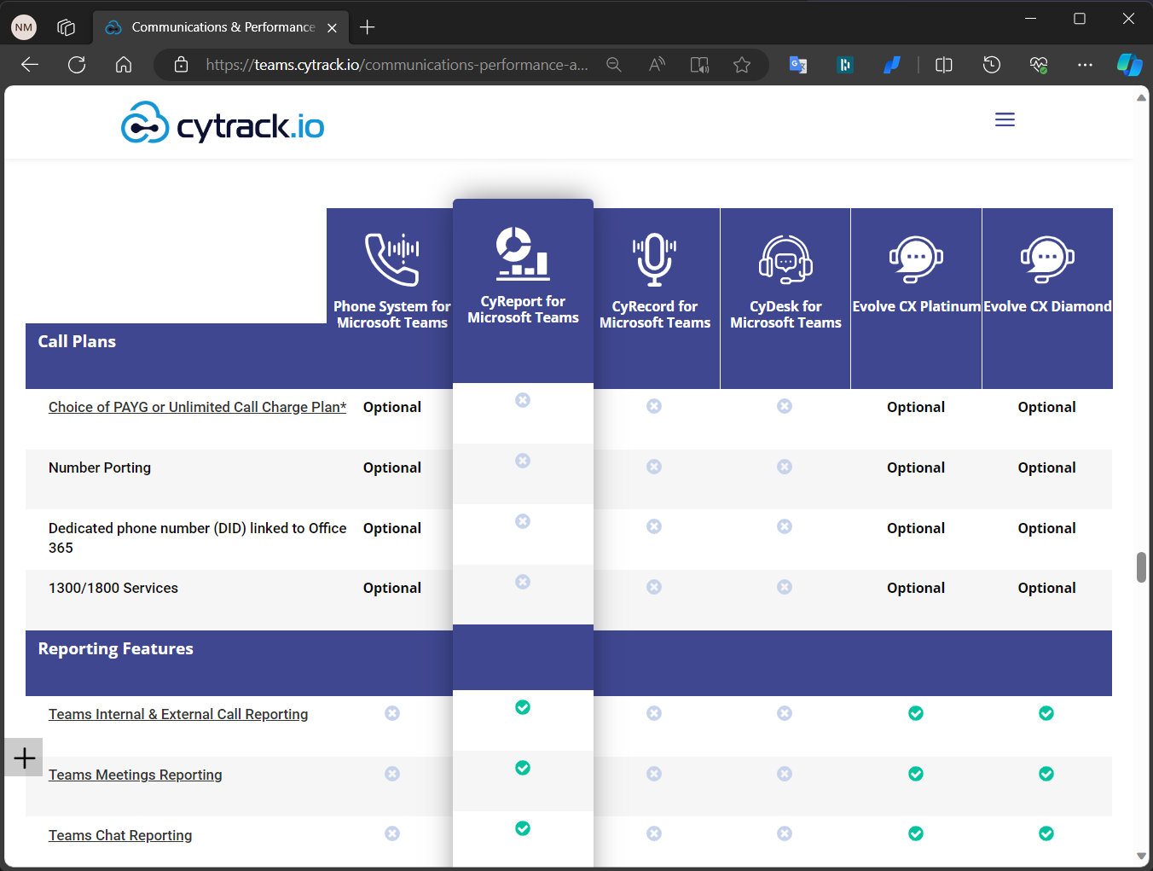
Sales & Marketing Support
Brochures
White Papers
Micro Web Sites
Marketing Services for co-branding
Online Webinars
demo movies
Partner Account Managers
Pre Sales
NFR programs for partners

Slide 18

Sales Toolbox
Partner Web Site & Sales Toolbox
CyReport for Teams micro site (for customers)
2 min intro of CyReport for Teams
5 min demo walkthrough
Get started Guide – how to get it on Appsource & Teams Store
Adoption Poster (QR code)
Pitch Deck pptx
CyReport for Teams Marketplace Link
CyReport for Teams – Purchasing via the Microsoft Marketplace Walkthrough
CyReport for Teams Deployment & Support Guide
Cytrack Deployment Services – CyReport Analytics for Teams – Scope of Service and Engagement
CyReport for Teams Online User Guide

Slide 19
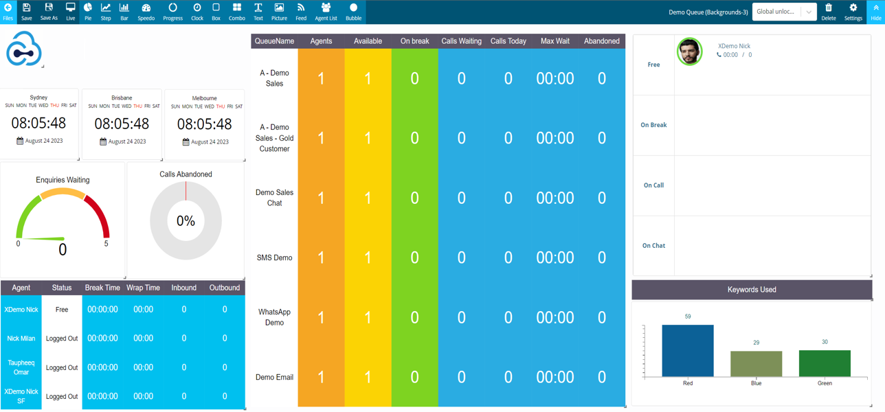

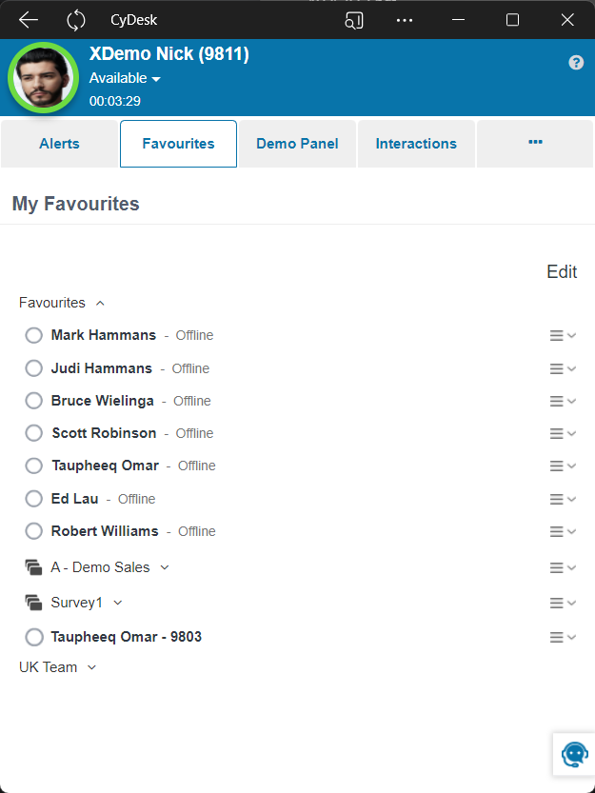
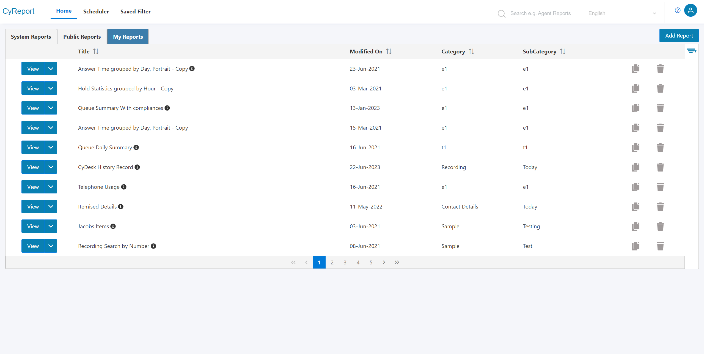
Add you own brand with our brand portal

Slide 20

NEOS Wins Platinum
Life Insurer of the Year
“We understand that our success is intrinsically linked to the partnerships we have cultivated with CyTrack,
and we’re grateful for the excellent products, services, and support you have provided over the years. You
have consistently delivered on your promises, which has helped us maintain our high standards and exceed our
customers’ expectations.
Results
NEOS operates within Microsoft Teams client interface for all operations
NEOS specific regulatory requirements and ongoing reporting & compliance are addressed
Platform to build upon for advanced customer services such as voice recording, automatic voice transcription, keyword analysis and analytics, and other digital channels for customer engagement and AI services
David Huang
Chief Technology Officer, NEOS

Slide 21
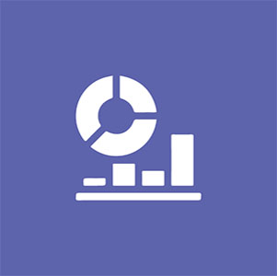
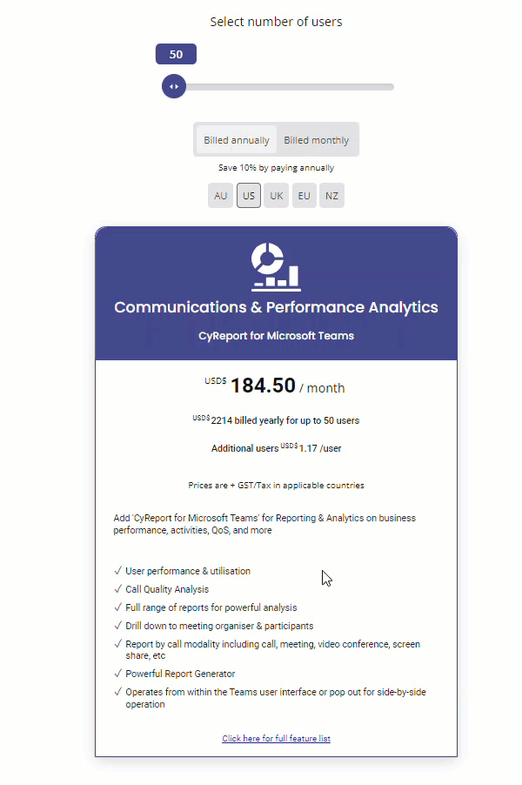

Pricing Plan
Users | Package | Additional
50 | $295 | $1.95
100 | $375 | $1.95
250 | $620 | $1.75
500 | $980 | $1.50
1000 | *
In $AU – access our international price page here
Save 2.5% by signing for 24 months
Save 5% by signing for 36 months
Save an additional 10% on all plans by paying annually
Contact sales for win deal pricing for 1000+

Slide 22

See it in action: CyReport in Teams

Slide 23


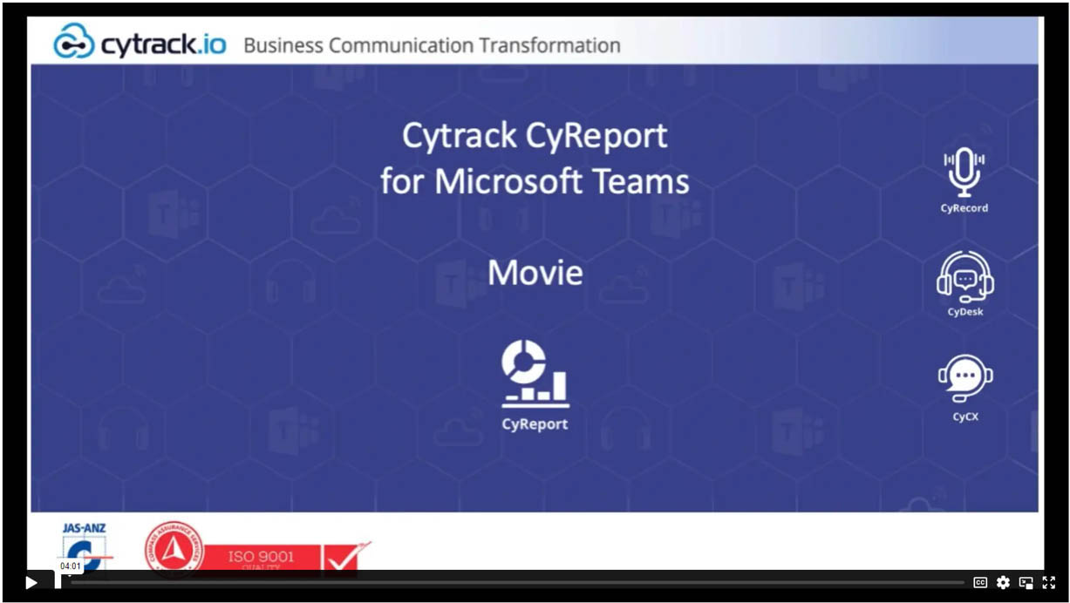
CyReport for Microsoft Teams
Business Context in this demo
Microsoft for Teams is used extensively for your hybrid workers collaboration together and interaction with your customers. It’s essential that you can monitor and report on performance and activities within your business.
How long are your customers waiting to be answered?
Are customers abandoning or overflowing to back up queues/voicemail?
Can you compare individual agent statistics to identify and reward top performers?
Are your staff happy and motivated?
Learn more to see how CyReport inside Microsoft Teams really shines !
https://vimeo.com/831340058/76cb5d8fe1

Slide 24

Get the app now
1
Visit Teams App Store to get started with CyReport for Microsoft Teams
Learn more
Visit AppSource to see the app details and experience screenshots
Notes:
Call to action
Update this slide to include the AppSource link to your solution

