Slide 1
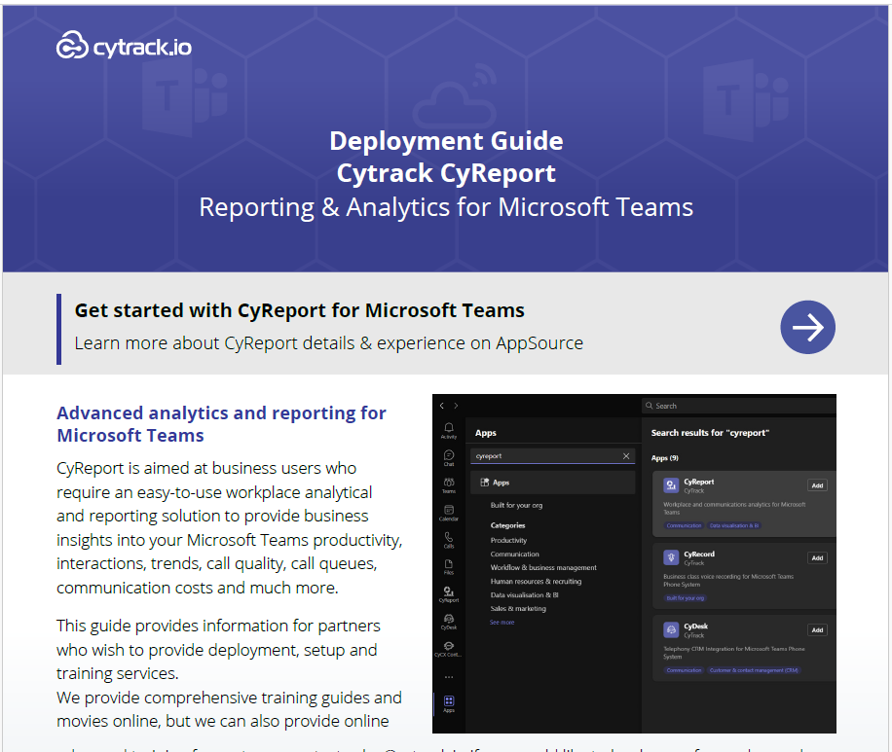
Business Communication Transformation
Product
Overview

Slide 2
Meet the User Interface

Slide 3
Understanding Report Headings

